Slide 1

Power BI Git-ting CI/CD
Kristyna Hughes

Slide 2


About Me ~ Kristyna Hughes
Senior data & analytics consultant at 3Cloud, PASS MN Board Member, Lexington Data Technology Group co-organizer , co-author on DataOnWheels, co-founder of Data On Rails
My experience includes implementing and managing enterprise-level Power BI instances, training teams on reporting best practices, learning new coding languages to hack into Power BI, and building templates for scalable analytics.
Check out my blog: https://dataonwheels.wordpress.com/
Check out my blog platform: https://dataonrailsblog.wordpress.com/
Connect on LinkedIn: https://www.linkedin.com/in/kristyna-hughes-dataonwheels/
Connect on Twitter: @data_dragoness
GitHub w/ Slides

Slide 3
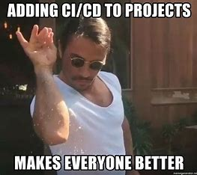
What is Git?
Source control management
Enables collaboration
Captures version history
Continuous integration and continuous development (CI/CD)

Slide 4
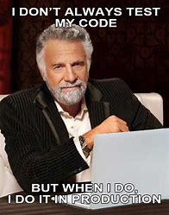
Why do we need CI/CD?
CI/CD stands for continual integration and continual development
Report design is never done, as the business changes and evolves so should the reporting
But do we really need to do all this? I mean I tested enough before I published the report

Slide 5
Code for Future You
Unfortunately, nobody is perfect
Stakeholders change their minds
The power of CI/CD lies within the ability to make a copy of your code (or report) to develop and test against while your stakeholders interact with the current version
Using git also enables multiple developers to work on the same project at the same time

Slide 6
Useful Git Commands & Definitions
Commands
Sync = performs a pull from your remote branch and a push to the same remote branch
Pull = grabs any new items or changes that have been made to a selected branch and adds them to your branch
Push = adds new items or changes from your local branch to the selected remote branch
Fetch = grabs new items and changes from a selected branch and shows them to you. Does not merge these into your branch unless you specify
Checkout = creates a new branch based on a specified branch
Stage = select what changes you would like to apply to main
Commit = send staged changes up to the remote branch
Definitions
Git = a development operations (devops) tool used for source code management that allows developers to work together on different pieces of the same project
Branch = copy of code where individuals make changes and run tests against code
Main = the copy/branch of code that is live in production
Pull Request = process for peer review before code is merged back to the main branch
Merge = grabs all the pieces of code from the branch and adds them to main
Conflict = occurs commonly when changes are made in a branch to a file that was deleted from main or changed from a different branch

Slide 7


Slide 8
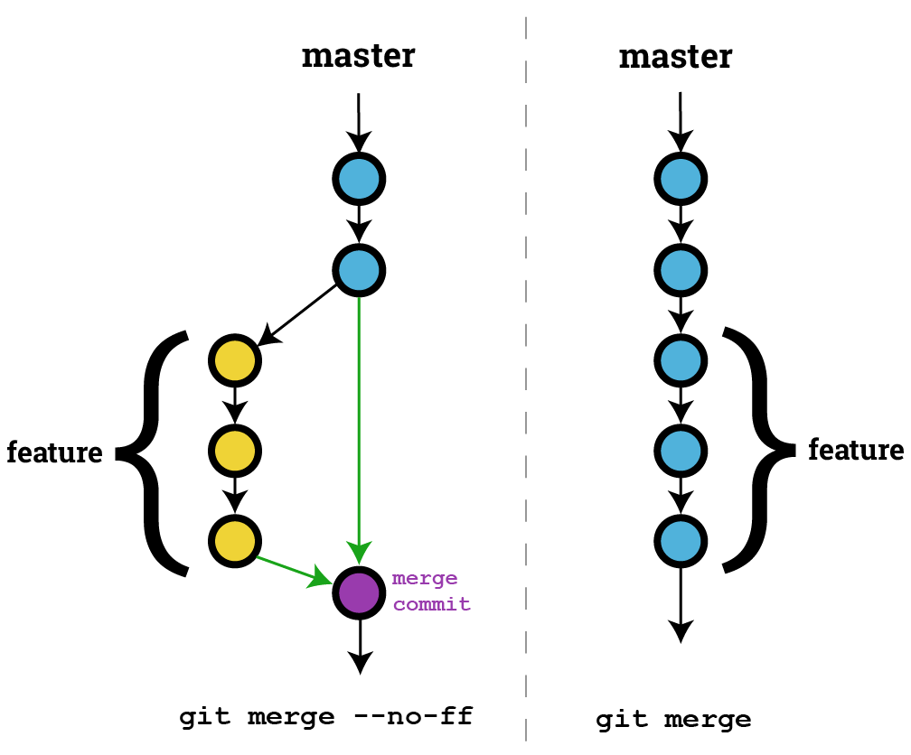

Let’s Git Metaphorical

Slide 9
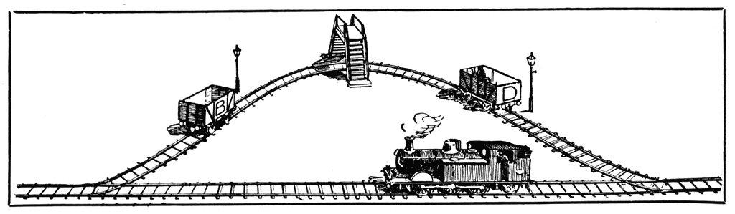
Git Station
Pull Push Sync
Stage
Commit
New Branch
Pull Request
Checkout
Merge
Main
File Copy
Command
Stop Point

Slide 10

How-To Implement CI/CD
Option 1 (premium only):
Git-enabled workspaces within a Power BI pipeline
Option 2 (premium per user):
Power BI pipeline and repository
Option 3 (pro or E5):
Repository and screenshare code reviews

Slide 11

Demo Time!

Slide 12

Questions?

Slide 13

Don’t forget to connect, thanks for listening!
Blog: https://dataonwheels.wordpress.com/
Email: Kristyna@dataonwheels.com
Twitter: @data_dragoness
LinkedIn

